Slide 1


Joe Davis
May 28, 2025

Slide 2

Outline
Executive Summary
Introduction
Methodology
Results
Conclusion
Appendix

Slide 3
Executive Summary
Summary of methodologies utilized:
Data Collection
Data Wrangling
Exploratory Data Analysis with Data Visualization
Exploratory Data Analysis with SQL
Building an Interactive Map with Folium
Building a Dashboard with Plotly Dash
Predictive analysis
Summary of all results from above methodologies:
Exploratory Data Analysis Results
Interactive Analytics via Screenshots
Predictive Analysis Results

Slide 4
Introduction
Project background and context
SpaceX advertises on its website that the Falcon 9 rocket cost 62 million dollars, with other providers costing as much as 165 million dollars.
SpaceX saves $s in the resuse of the first stage engine. IF a determination can be made when the first stage will land safely, the true cost of a launch and ability to minimize launch risks can be determined and these findings can be applied to Space Y’s own program.
Problems you want to find answers
For a given set of features related to Falcon 9 rocket launches, will the first stage of the rocket land successfully?

Slide 5

Section 1

Slide 6
Methodology
Data collection methodology:
Used SpaceX Rest API
Used Web Scraping from Wikipedia
Perform data wrangling
Filtered the data
Dealt with missing values
Used One Hot Encoding to prepare the data for binary classification
Perform exploratory data analysis (EDA) using visualization and SQL
Perform interactive visual analytics using Folium and Plotly Dash
Perform predictive analysis using classification models
Built, tuned, and evaluated classification models to ensure the best findings

Slide 7
Data Collection – SpaceX API
API
Acquired historical data from Open Source REST API for SpaceX
API utilized is https://api.spacexdata.com/v4/rockets/
Requested and parsed the launch data using the GET request
Filtered the dataframe to only include Falcon 9 launches
Replaced missing payload mass values from classified missions with mean
GitHub URL: Data Collection API
1
Request launch data from SpaceX API
Create a dataframe from the dictionary
5
2
Decode the response using .json() and convert to a df using .json_normalize()
Filter the df to only include Falcon 9 launch data
6
For missing Payload Mass values, replace with calculated .mean()
7
3
Request launch info by applying custom functions
4
Convert data obtained to a dictionary
8
Export the data to a .csv file

Slide 8
Data Collection – Web Scraping
Web Scraping
Acquired historical data from Wikipedia for “List of Falcon 9 and Falcon Heavy launches”
Wikipedia data link utilized: https://en.wikipedia.org/wiki/List_of_Falcon_9_and_Falcon_Heavy_launches
Extracted all columns/variable names from the HTML table header
Parsed the table and converted it to a Pandas dataframe
GitHub URL: Data Collection via Web Scraping
1
Request Falcon9 launch data from Wikipedia
Create a dictionary from the obtained data
5
2
Create a BeautifulSoup object from the HTML response
Create a Pandas dataframe from the dictionary
6
3
Extract column/variable names from the HTML header
Export the data to a .csv file
7
4
Create a dataframe by parsing launch HTML tables

Slide 9
Data Collection – Data Wrangling
Web Scraping
Acquired historical data from Wikipedia for “List of Falcon 9 and Falcon Heavy launches”
Wikipedia data link utilized: https://en.wikipedia.org/wiki/List_of_Falcon_9_and_Falcon_Heavy_launches
Extracted all columns/variable names from the HTML table header
Parsed the table and converted it to a Pandas dataframe
GitHub URL: Data Wrangling
1
Performed exploratory data analysis and determined training labels
Create a dictionary from the obtained data
5
Create a Pandas dataframe from the dictionary
6
2
Create a BeautifulSoup object from the HTML response
Export the data to a .csv file
7
3
Extract column/variable names from the HTML header
4
Create a dataframe by parsing launch HTML tables

Slide 10
EDA with Data Visualization
Various charts were plotted:
Flight Number vs Payload Mass (Scatter Plot), Flight Number vs Launch Site (Scatter Plot), Payload Mass vs Launch Site (Scatter Plot), Success Rate for Each Orbit Type (Bar Chart), Flight Number vs Orbit Type (Scatter Plot), Payload Mass vs Orbit Type (Scatter Plot), Launch Success Rate by Year (Line Chart)
The majority of charts created were of the Scatter variety. These show the relationship (potential or concrete) between variables. If a solid relationship, can be utilized for machine learning.
Bar charts are used to show comparisons within discrete categories. Shows measure values within a category (or categories).
Line charts show data trends over time.
GitHub URL: EDA with Data Visualization

Slide 11
EDA with SQL
SQL queries performed:
Names of unique launch sites in the space mission
Displayed 5 records where launch sites begin with the string ‘CCA’
Displayed the total payload mass carried by boosters launched by NASA (CRS)
Displayed average payload mass carried by booster version F9 v1.1
Listed the date when the first successful landing outcome in a ground pad was achieved
Listed the names of the boosters with success in drone ship and payload mass >4k and <6k
Listed the total number of successful and failed mission outcomes
Listed all the Booster Versions that carried the maximum payload mass
Listed records displaying month names, failure landing outcomes in drone ship, booster versions, and launch site for year = 2015
Ranked the count of landing outcomes between 2010-06-04 and 2017-03-20 in descending order
GitHub URL: EDA with SQL

Slide 12
Build an Interactive Map with Folium
Markers for Launch Sites
Added marker with a Circle, Popup Label, and Text Label for NASA Johnson Space Center using the center’s lat and long coordinates as the start location
Added markers with Circle, Popul Labels, and Text Labels for all Launch Sites using their respective lat/long coordinates to show their locations relative to the Equator and nearest coasts
Markers colored to designate success and failures were added (Green and Red) to show which Launch Sites have high success rates
Colored lines were added between Launch Sites and nearest landmarks (e.g. Railways, Highways, Coastlines, Cities) to show proximity to these locations
GitHub URL: Interactive Visualizations with Folium

Slide 13
Build a Dashboard with Plotly Dash
Created a Launch Sites Dropdown List
A dropdown list to enable Launch Site user selection
Created a Pie Chart showing Successful Launches
Ability to select for All Sites or Individual Site at user discretion
Created a Slider of Payload Mass Range
Enables the user to see results with a quick slider function for various Mass values
Created a Scatter Chart showing Payload Mass vs Success Rate
Shows correlation between Payload Mass and Launch Success Rate for different booster versions
GitHub URL: Plotly Dash

Slide 14
Predictive Analysis (Classification)
Utilized Train/Test machine learning to analyze the data using various methods.
GitHub URL: Machine Learning
1
Created a NumPy arrach from the column “Class” in the dataset
Calculated accuracy of test data using “score” method
5
2
Standarized the data in “X” and reassigned it to variable “X” using StandardScaler
Examined confusion matrices
6
Determined best performing method: all performed well. Training data slightly better.
7
3
Split data into training and test sets using train_test_split function
4
Created logistic regression object then a GridSearchCV object (cv=10)

Slide 15
Results
Exploratory data analysis results
Interactive analytics demo in screenshots
Predictive analysis results

Slide 16

Section 2

Slide 17
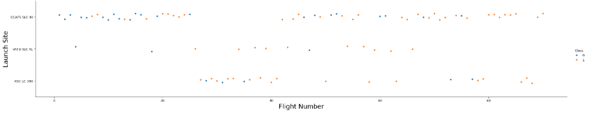
Flight Number vs. Launch Site
Explanations:
Mixed success rates for earlier flights.
~50% of launches from CCAFS SLC 40 site
Higher success rates at other 2 locations
Over time, ratio of success to failure has improved. Net new launches show “success” as a probable outcome

Slide 18
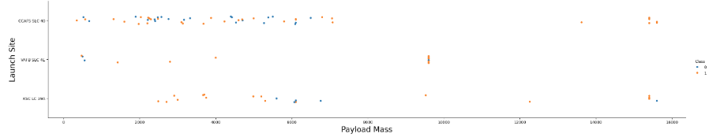
Payload vs. Launch Site
Explanations:
Majority of payloads over 2k were successful
The higher the payload (across all launch sites), the higher the success rate
KSC LC 39A shows a near 100% success rate for loads <6k

Slide 19
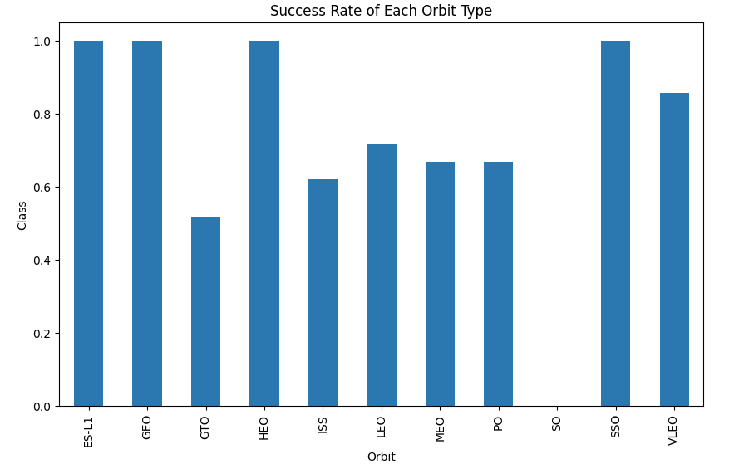
Success Rate vs. Orbit Type
Explanations:
Highest success rates (100%) for orbit types ES-L1, GEO, HEO, SSO
SO shows a 0% success rate
Intermediary success (>50%) with remaining orbit types (GTO, ISS, LEO, MEO, PO, VLEO)

Slide 20
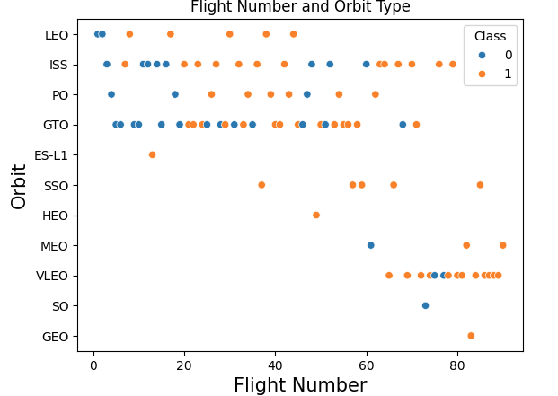
Flight Number vs. Orbit Type
Explanations:
LEO/VLEO orbit types have a high success rate based on number of launches
GTO does not seem to have a direct success correlation based on flight numbers

Slide 21
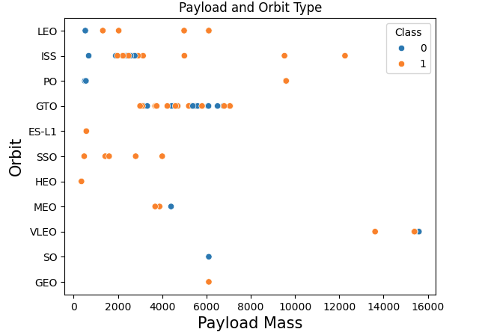
Payload vs. Orbit Type
Explanations:
GTO orbit type displays mixed (trending towards positive) results between 2.5k and 7k
LEO, MEO, and VLEO show positive results with a negative outlier VLEO at high mass

Slide 22
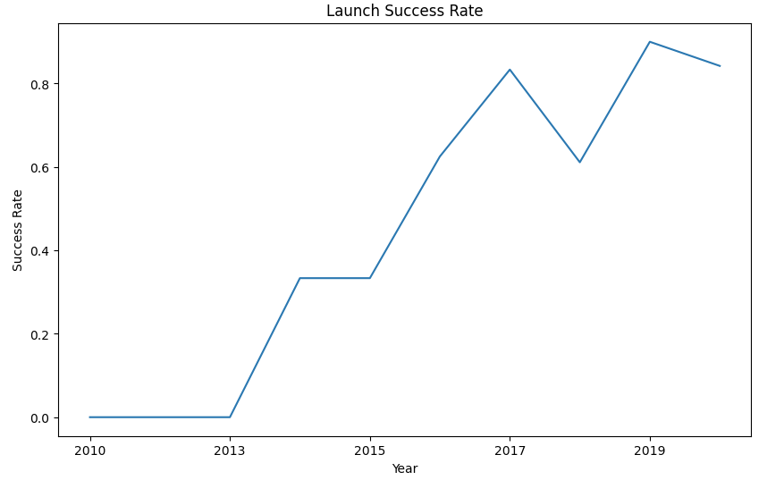
Launch Success Yearly Trend
Explanations:
Success rate shows an overall positive increase over time

Slide 23
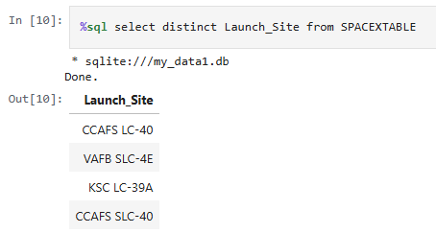
All Launch Site Names
Explanations:
4 unique Launch Site name values from SpaceX dataset

Slide 24
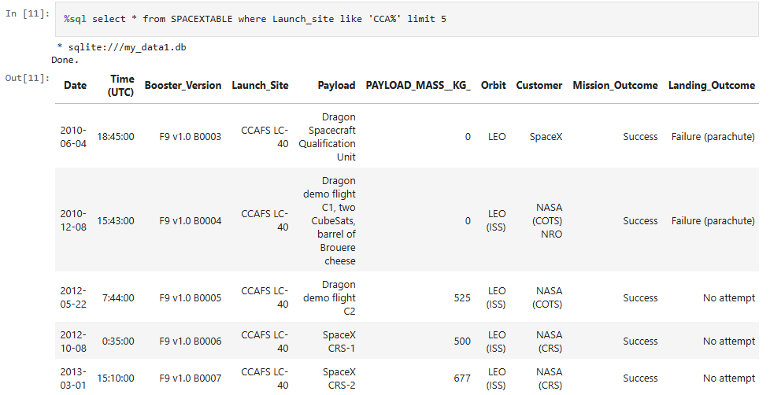
Launch Site Names Begin with 'CCA'
Explanations:
5 records displayed from dataset with string “CCA”

Slide 25
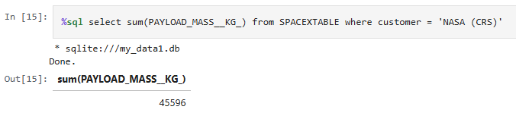
Total Payload Mass
Explanations:
SUM of PAYLOAD_MASS_KG field from SpaceX data table. Mass carried by boosters.

Slide 26
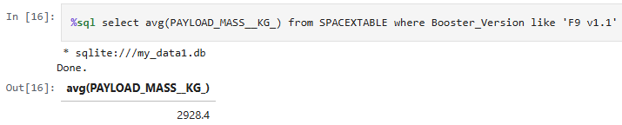
Average Payload Mass by F9 v1.1
Explanations:
Calculation of Average Payload Mass for specific booster version F9 v1.1

Slide 27
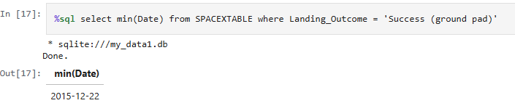
First Successful Ground Landing Date
Explanations:
Date selection for when the first landing outcome for SpaceX for Ground Pad was successful

Slide 28
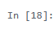
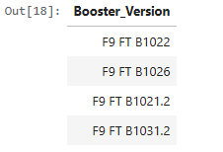
Successful Drone Ship Landing with Payload between 4000 and 6000
%sql select Booster_Version from SPACEXTABLE where (Landing_Outcome = 'Success (drone ship)') and (PAYLOAD_MASS__KG_ between 4000 and 6000)
* sqlite:///my_data1.db Done.
Out[18]:
Explanations:
Date selection (Booster Versions) for successful Drone Ship landings where Payload Mass is between 4k and 6k

Slide 29
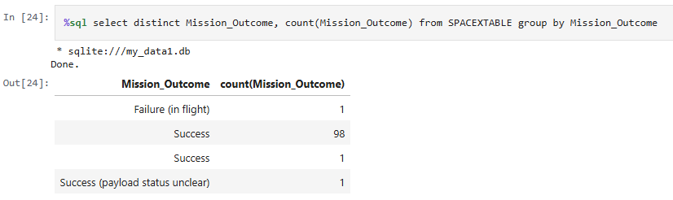
Total Number of Successful and Failure Mission Outcomes
Explanations:
Date selection for total of Success and Failure outcomes listed by “Mission Outcome” type

Slide 30
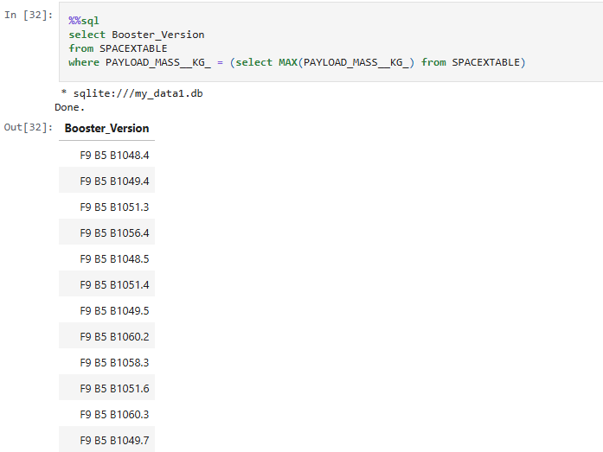
Boosters Carried Maximum Payload
Explanations:
Booster Type selection for those that have carried the maximum payload mass

Slide 31
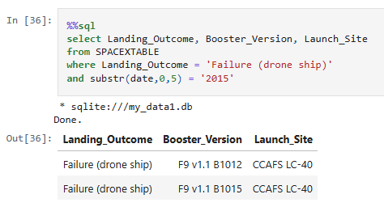
2015 Launch Records
Explanations:
Listing records for failed landing outcomes for drone ship and booster versions

Slide 32
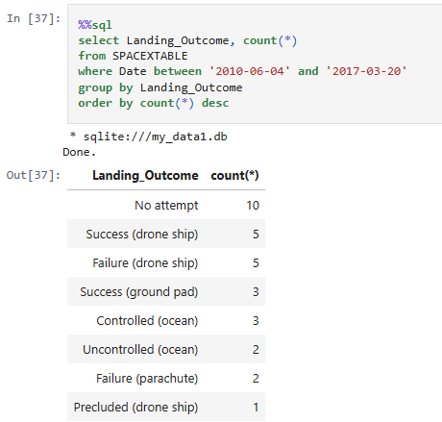
Rank Landing Outcomes Between 2010-06-04 and 2017-03-20
Explanations:
Ranked outcomes for launches between 2010-06-04 and 2017-03-20 presented in descending order

Slide 33

Section 3

Slide 34
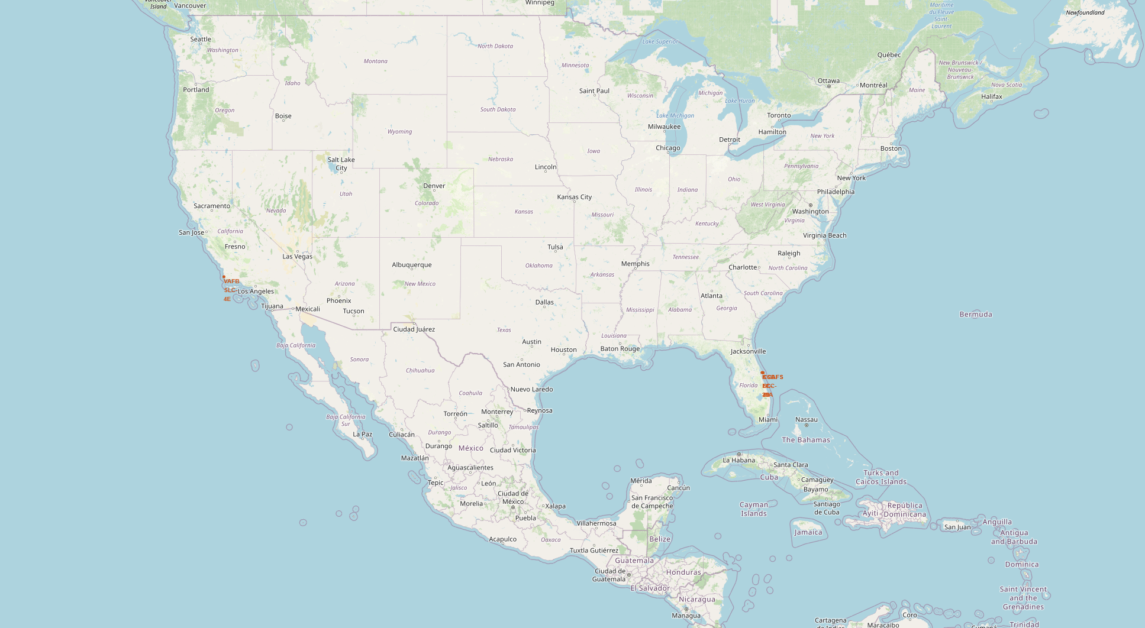
All Launch Site Locations - Global
Findings:
All launch sites are located near coastal areas. This provides a safe launch environment away from population centers to minimize risk of failure.

Slide 35
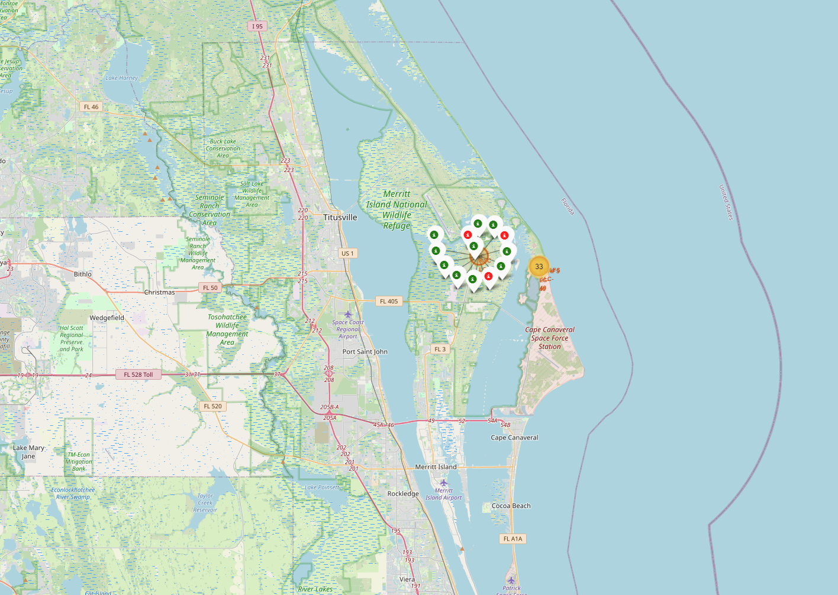
Launch Outcomes – Color Coded
Findings:
Drilling into site specific information, color coding allows the viewer a quick scan of the data outcomes
In this case, Red = Failed Launch, Green = Successful Launch.
This is for Site KSC LC-39A

Slide 36
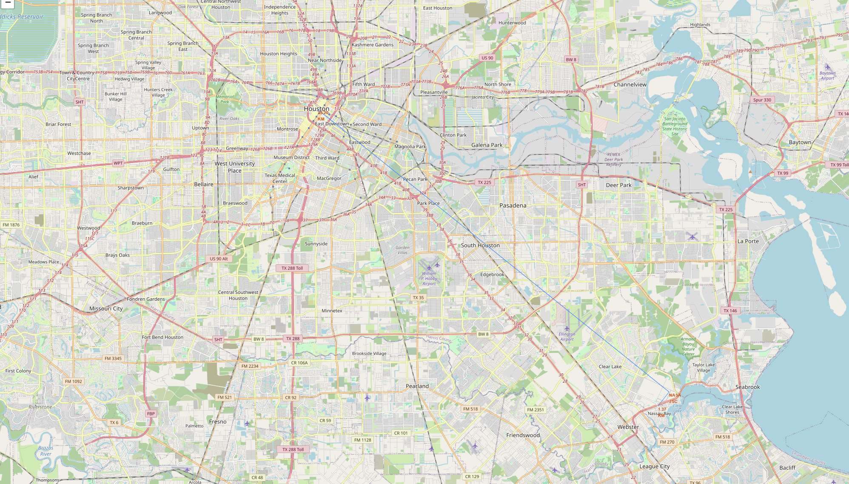
Launch Site Proximity to Landmarks
Findings:
For this example, launch site proximity (NASA JSC) to nearest large city, Houston, is 25.2 km (blue line)
Proximity to population centers and areas of concern are necessary to calculate the risk involved for a failed launch

Slide 37

Section 4

Slide 38
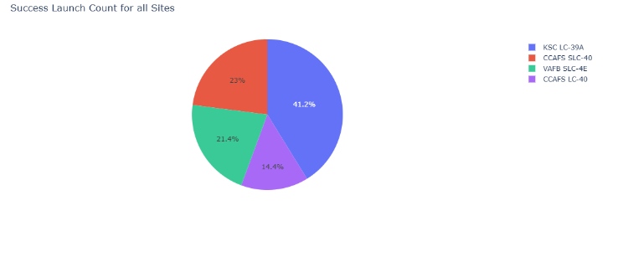
Launch Success Count for All Sites - Plotly
From the pie chart, we can discern that the most successful launch site is clearly KSC LC-39A (41.2%) and the least successful is CCAFS LC-40 (14.4%)

Slide 39
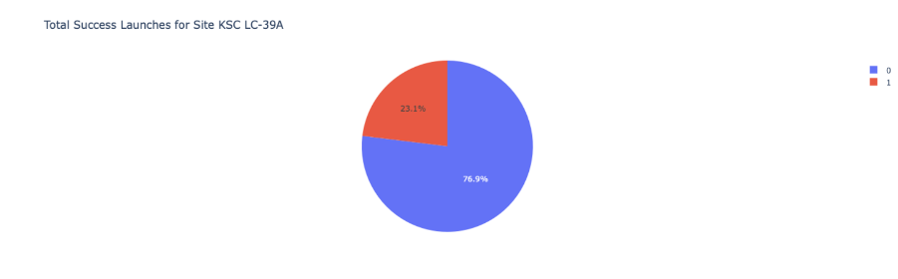
Launch Site with Highest Launch Success Ratio
KSC LC-39A has the highest success among the measured launch sites at 76.9%.

Slide 40
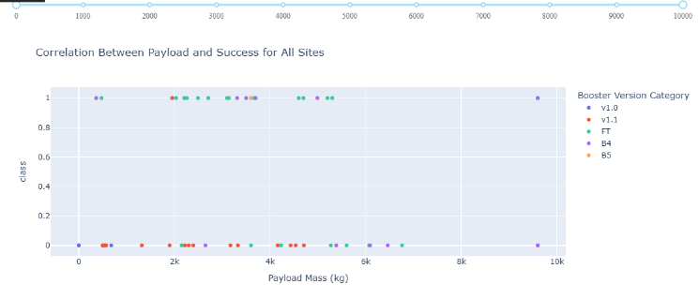
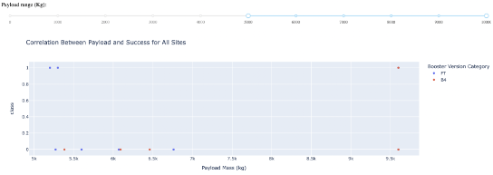
Payload Mass vs Launch Outcome for all Sites
The top chart shows all data for all sites. The Second view is for the middle of the range. Highest success from the data appears between 2kg and 5.5kg payloads.

Slide 41

Section 5

Slide 42
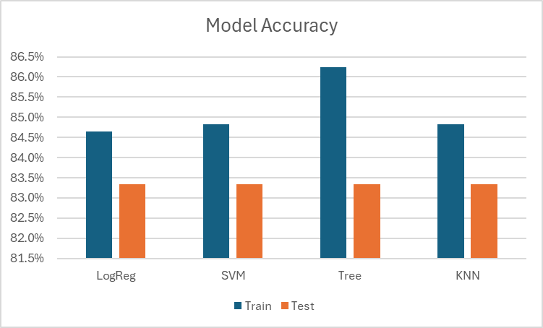
Classification Accuracy
When viewing the Test models for accuracy, all 4 methods performed at the same level ~83.33%
However, the Training model data performed better in all cases. The best being “Tree.”
IF we were to combined our data sets, overall Tree would be the best indicator of accuracy

Slide 43
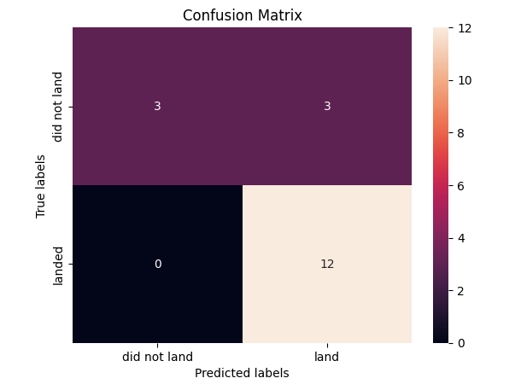
Confusion Matrix
Displayed is the Tree Model Confusion Matrix
We can see that false positives (upper right quadrant) with such a small dataset (18 values) create an accuracy issue

Slide 44
Conclusions
As shown in the previous 2 slides, the Decision Tree method is the best machine learning algorithm to utilize for the SpaceX launch dataset.
The highest number of successful launches occurred at site KSC LC-39A
The success rate for launches has improved consistently over time
Highest success rates (100%) for orbit types ES-L1, GEO, HEO, SSO
Majority of payloads over 2k were successful

Slide 45


